Slide 1

Machine Learning – Certification Program (Aug 2018)
Code Assignment – Module 3
Phone : +91 9999658436
Offices : Bengaluru, New Delhi
Email : contact@cellstrat.com
Web : www.cellstrat.com
CellStrat™ Confidential. All Rights Reserved.

Slide 2
Module 3 (Set 2 code)
Techniques of Machine Learning

Slide 3
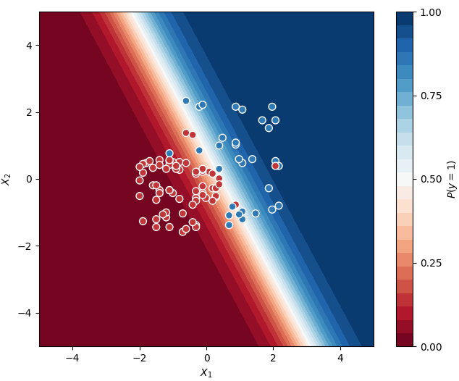

Tutorial
Module 3 - Classification-LogisticRegression.ipynb
Tutorial name :- Predict whether consumers will buy houses or not, given their age and salary.
Exercise –
Q1 - What issues do you see in the plot which is produced by this code ? How to solve these issues ?
There are outliers .Could be false negatives and false positives
Q2 – What is the meaning of fit and predict ?
Fit : Using the data available to make prediction thru employing various model..
Here we see if the data is fitting in the model.
Predict: predicting outcome with new data after a model is trained with old data
Q3 – How many true positives do you see in the classifier result in the original program provided to you ? What is meant by true positive and true negatives ?
Here we have 24 true positives and 65 True Negatives.TP’s are presdicted yes and actual yes and TN’s are presdicted no and actual is also nos
Q4 – What is the purpose of StandardScaler class ?
It is a class sklearn package which scales date and makes sure that no parameter important in weights just because of it’s higher numeric value
Eg. Age: 50 years
Weight inpounds :200 pounds.
Here weight has more numeric value and has equal importance as age in parameter. So both parameters are scaled in such a way
It wont hurt the importance of other because of it usual higher numeric value

Slide 4
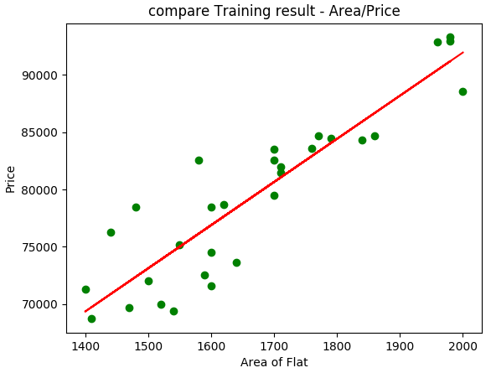
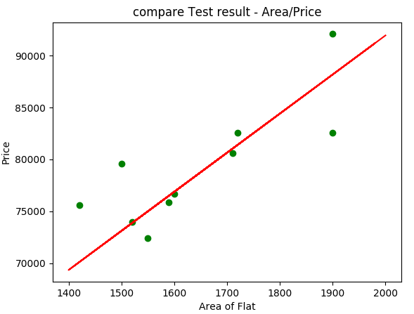
Tutorial
Module 3 - Regression-LinearRegression.ipynb
Tutorial name – Predict house prices based on area of the house
Exercise –
Q1 - Is the trained model accurate and why ?
Yes. The regression line passes thru the center of all values
Q2 - What is the approximate price of the house for houses with area (give approx. values)
1700=8000
1900=8500s

Slide 5
Tutorial
Module 3 - Regression-PolynomialRegression.ipynb
Tutorial name – Insurance Premium Calculation based on age
Exercise –
Q1 – For this dataset of insurance premium calculation, which is a better model Linear Regression or Polynomial Regression and why ?
Polynomial Regression is best fit because data is distributed in curved way and Linear regression may match only highest and low values where the values in center misses the context.
Q2 – Try Polynomial regression with 2,3,4, 10 degree polynomials and interpret the results. Which one is best for this dataset provided ?
Degree 2 is under fitting and 10 is over fitting..Here 4 should be good.
Q3 – For degree 3 polynomial regression, what is the predicted insurance premium for ages 29, 45, 53 and 80 ?
7059 8327 14075 217503

